Slide 1

Food Ordering System
Group members with StudentId
Purvesh Gangapurkar 20104063
Rahul Patil 20104073
Ambadas Malegave 20104112
Om Chavan 20104056
Project Guide
Ms. Geetanjali Kalme

Slide 2
Contents
Introduction
Objectives
Scope
Features / Functionality
Project Outcomes
Technology Stack
Block Diagram if applicable

Slide 3
1. Introduction
Problem Identified :
The major problem faced by customers was travelling and time management.
One of the major problem in this current situation is maintaining social distancing due to COVID-19 pandemic.
Solution Proposed :
By getting food at doorstep customers will save both travelling and time
By using Online food ordering system (APSITO) everyone is safe as they are maintaining social distancing by ordering the food from there home itself.

Slide 4
2. Objectives
To develop online ordering system in Restaurant.
To develop user interface for online restaurant system.
To provide online menu for customer.
To Increase Efficiency through detailed reporting.(for both customer and restaurants)

Slide 5
3. Scope
Can be useful for restaurants to increase their sales.
Can be helpful for a customer to get food to deliver in the safe environment of a home.
Discount and can be available for the customers.

Slide 6
4. Feature /Functionality
User Friendly and Easy To Use :
Customer panel features allow users to find and order their favourite foods with just a few clicks.
Order Details:
You can Keep Track of your Order.
You can Remove your food items.
Review Section :
Customer can share their Experience/Opinion by rating the app.
Banners :
Today’s special dishes and offers are displayed.
5. Printable Invoice:
Users can print/download invoice.

Slide 7
5. Outcome of Project
User Can Log In.
Users can order from available Food options.
Customers can order food online with just a click of a button maintaining minimum human interaction in this pandemic.

Slide 8
5. Outcome of Project(continued)
4.Benefits for Restaurants:-
Efficient, customer and order management.
Can reach Thousands Of Customers at a time.
Free and Cheap Marketing.

Slide 9
6. Technology Stack
Front-end: Java Swing
Database: MySQL 8.0.26.0 (using PHPMyAdmin 8.0.13)
Integrated Development Environment (IDE): Eclipse
Platform: Windows 10/11

Slide 10
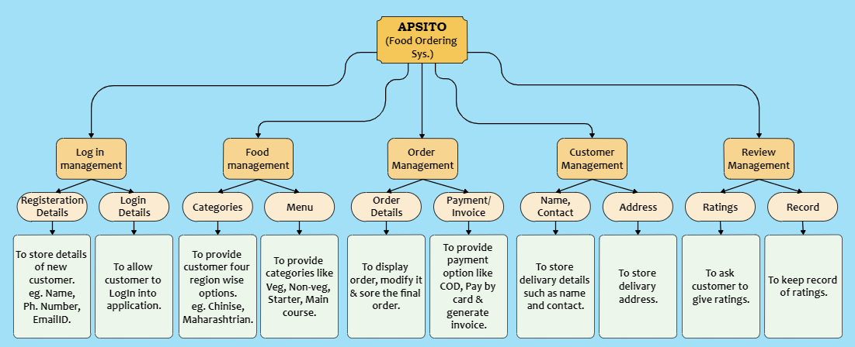
7. Block Diagram

Slide 11
Thank You.... !!!

